Slide 1
Joint R&D Program Workshop
2017.08.09
Subintern 조하혜

Slide 2
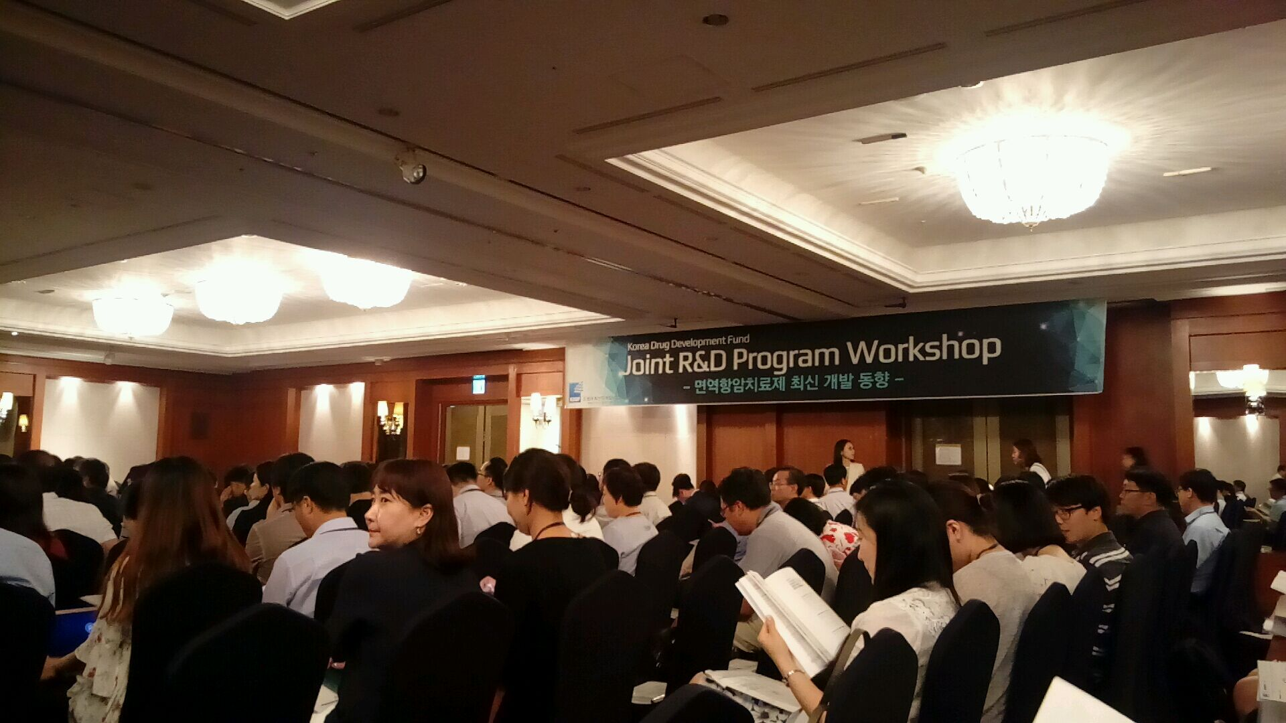
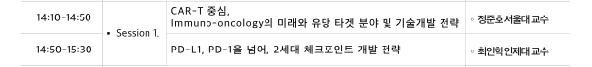

Slide 3
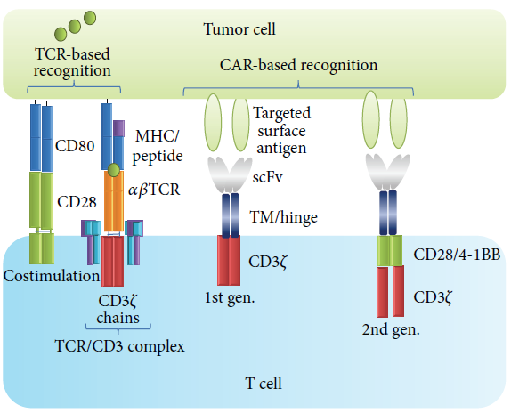
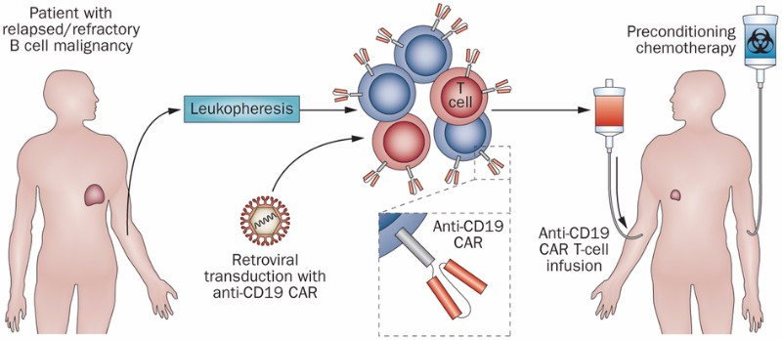
1. CAR T cell Therapy
CAR(Chimeric Antigen Receptor) T cell Therapy란?
환자의 면역계를 이용하여 암을 치료하는 Immunotherapy의 하나
Notes:
A rapidly emerging immunotherapy approach is called adoptive cell transfer (ACT): collecting and using patients’ own immune cells to treat their cancer. There are several types of ACT (see “ACT: TILs, TCRs, and CARs”), but the one that is closest to producing a treatment approved by the Food and Drug Administration (FDA) is called CAR T-cell therapy.

Slide 4
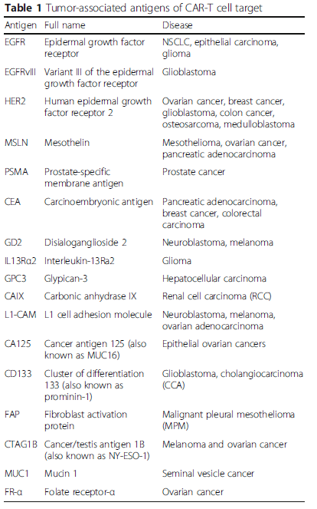
Target Antigen
CD4, CD19…
EGFR
HER2
Notes:
By modifying T cells to express chimeric antigen receptors (CARs) that recognize cancer-specific antigens, researchers can prime the cells to recognize and kill tumor cells that would otherwise escape immune detection. The process involves extracting a patient’s T cells, transfecting them with a gene for a CAR, then reinfusing the transfected

Slide 5
Indications
NHL
ALL
CLL
Multiple myeloma
Pancreatic cancer
Glioma
Brain tumor
기타 solid tumors

Slide 6
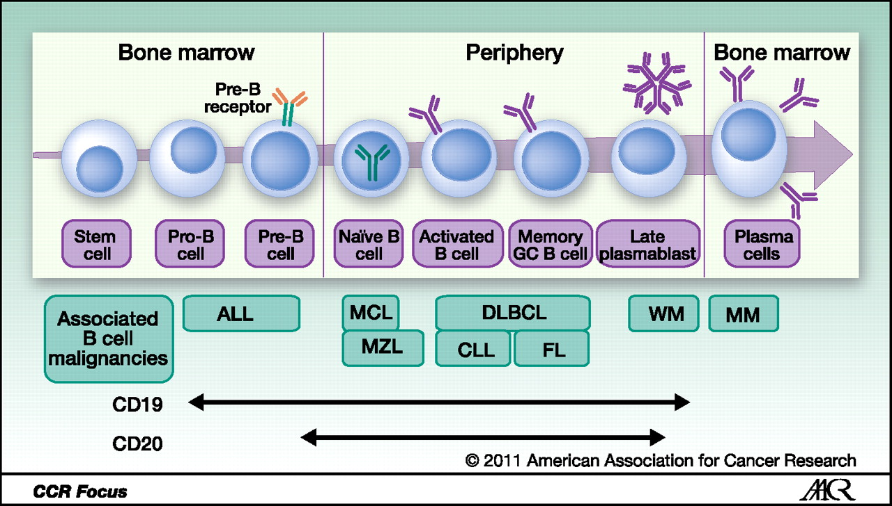
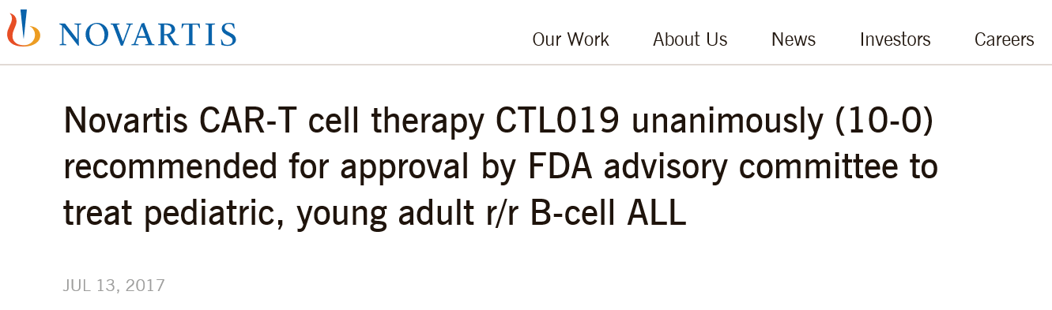
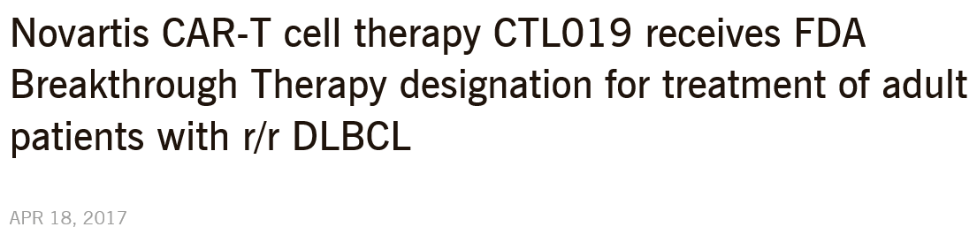
CTL019
Notes:
Novartis seems to be leading now — an FDA committee unanimously voted in favor of its CAR-T therapy CTL019, and a final decision is expected in October. Last November, the company presented results from a Phase II trial in B-cell acute lymphoblastic leukemia (ALL), which achieved remission in 82% of patients after 3 months. However, 50% of patients in the trial were reported to present severe side-effects.
The most investigated target to date is CD19, an attractive target for CAR-based therapy as it is present in most B cell leukemias and lymphomas but not in any normal tissue other than the B cell lineage.

Slide 7
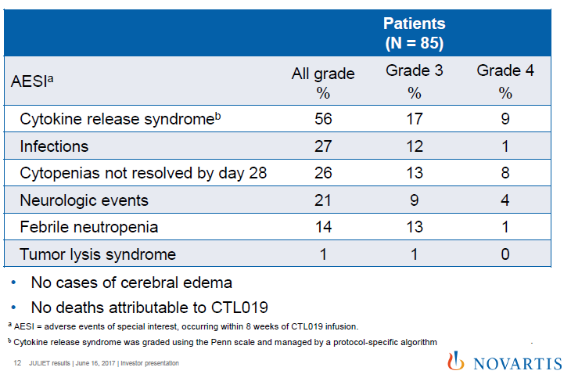
Adverse events
IL-6 ▲
IFN-γ ▲
Sz, Tremor, Confusion

Slide 8
On-target, off-tumor responses
The immune-mediated rejection of normal tissues that express the targeted antigen
Ex) B cell aplasias induced by CD19-targeted CARs(→manageable by IVIG)
The first fatal adverse event
occurred in a patient with colorectal cancer treated with high numbers of T cells expressing a third generation CAR targeting ERBB2/HER2.
The patient developed respiratory distress and cardiac arrests shortly after the T cell transfer and died of multisystem organ failure 5 days later.
⇒ Emerging solutions to improve CAR safety : Switch CAR T cell
Notes:
Predicted on-target off-tumor toxicity with depletion of normal B-cells has been reported in nearly all
patients treated with CD19 CAR T cells, and depending on the CAR configuration, B-cell aplasia lasts from months to years

Slide 9
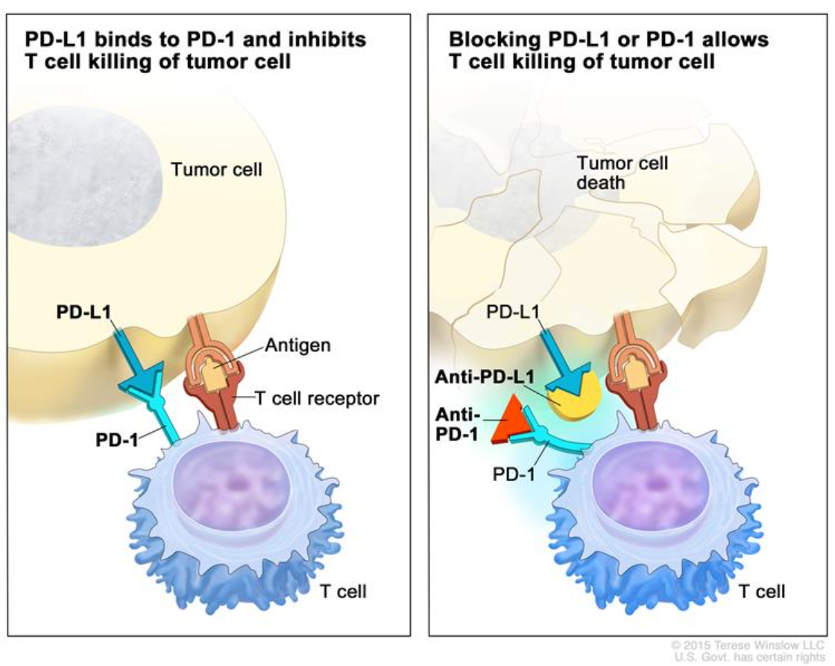
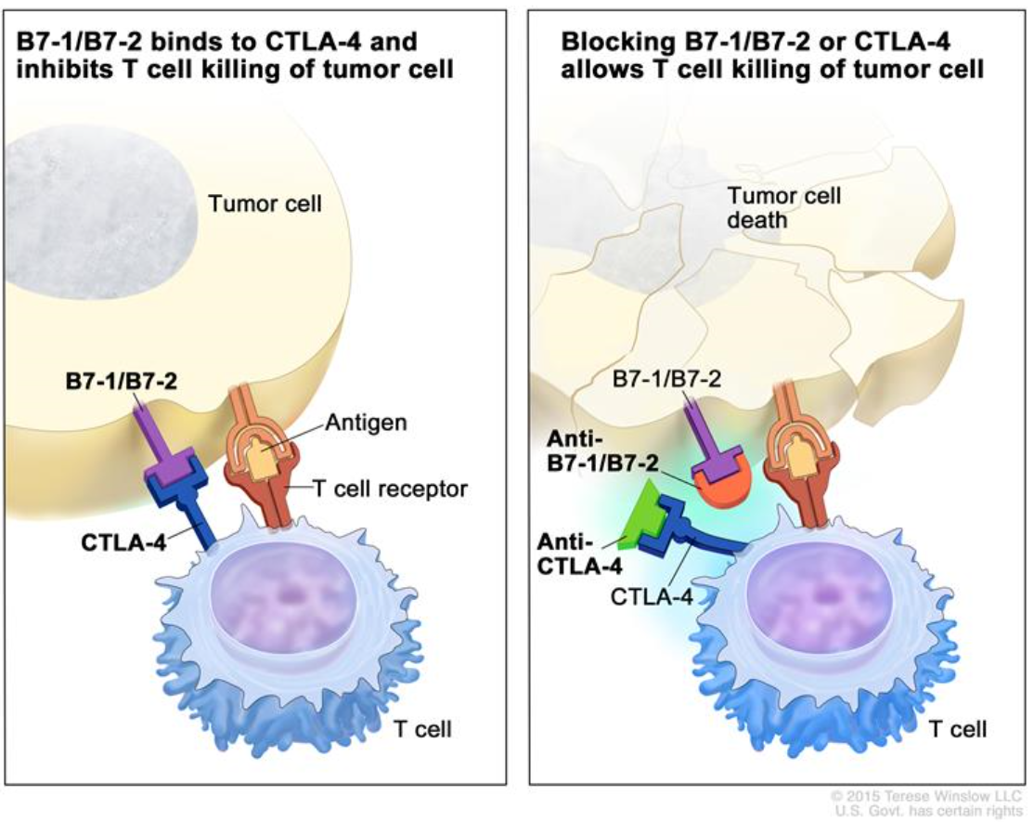
2. PD-1/PD-L1 Ab를 넘어서 Next generation immune checkpoint inhibitor
PD-1 inhibitors
Pembrolizumab (Keytruda)
Nivolumab (Opdivo)
PD-L1 inhibitors
Atezolizumab (Tecentriq)
Avelumab (Bavencio)
Durvalumab (Imfinzi)
CTLA-4 inhibitor
Ipilimumab (Yervoy)
Notes:
PD-1 is a checkpoint protein on immune cells called T cells. It normally acts as a type of “off switch” that helps keep the T cells from attacking other cells in the body. It does this when it attaches to PD-L1, a protein on some normal (and cancer) cells. When PD-1 binds to PD-L1, it basically tells the T cell to leave the other cell alone. Some cancer cells have large amounts of PD-L1, which helps them evade immune attack.
Nivolumab과 Pembrolizumab 결합 부위가 달라-> 치료효과도 다름(Pembrolizumab은 NSCLC에 치료효과 더 좋음)

Slide 10
Immune checkpoint inhibitor의 장점
1. 기존의 CTx와 다르다.
metastatic RCC; 치료 12주 째 간에 새로운 병변이 발생 → Progression?
but, 치료 지속 후 36주 째, Regression
2. 치료 중단 후에도 Durable response를 보인다.
3. 치료 범위가 넓다.
; Bladder cancer, Melanoma – Response rate > 50%
Lung cancer, LCC, H&N cancer – Response rate < 50%
4. CTx에 비해 QOL이 높다.
5. 환자의 나이와 무관하게 치료효과가 비슷하다.
Notes:
Durable Response Rate (DRR): The length of time (usually displayed in months), that a partial or complete response is observed, as a result of treatment. Some melanoma treatment trials only show 2% of patients having a durable response, across all of the patients in a trial group, being that it is such a problematic disease to treat. A durable response is a good indicator that tentative treatment method has a lasting effect and may be a viable therapy, if coinciding with an improvement in overall survival.

Slide 11
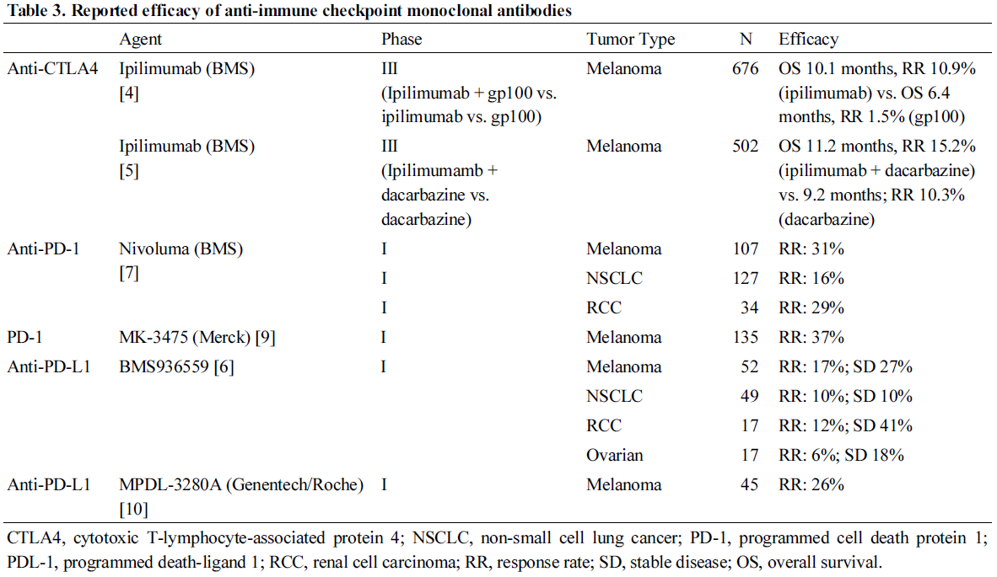
다른 Checkpoint inhibitor의 필요성
1. Non-responder가 아직도 많다(80% 이상)
2. 치료 후 overall survival 이 여전히 낮다.
3. 치료 전부터 PD-1/PD-L1 inhibitor에 내성을 가지고 있는 환자가 있다.
4. 치료 중/후에 재발되는 환자가 있다(acquired resistance).
5. PD-1 independent pathway가 있다.

Slide 12
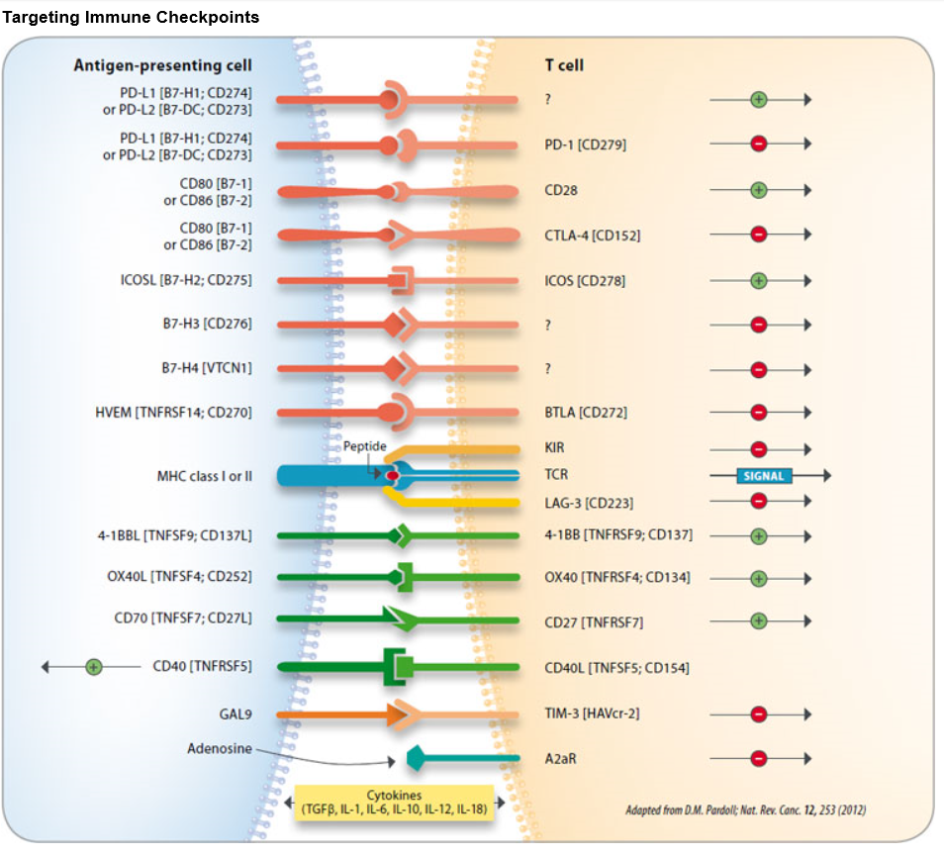
Notes:
In addition, blockade of other inhibitory receptors, such as BTLA (B- and T-lymphocyte attenuator), KIR (killer immunoglobulin-like receptors), TIM-3 (T cell immunoglobulin and mucin domain-containing protein 3), A2aR (adenosine 2A receptor), B7-H3 or H4 (B7 family members) either alone or in combination with a second immune checkpoint inhibitor has also been shown to enhance antitumor immunity. Costimulatory signaling proteins such as ICOS (inducible T cell costimulator), CD28 or the TNF family members 4-1BB (CD137), OX40, CD27 or CD40, have been shown to be involved in allergy, autoimmune or inflammatory diseases.
OX40, CD27, CD40 같은 T cell을 활성화시키는 immunomodulator의 경우 tight하게 조절하지 못하면 위험할 수 있다.

Slide 13
Next generation checkpoint inhibitor??
1. Objective response rate ↑
2. Durable response ↑
3. Tolerability ↑
4. Find different Mechanism of Action/Signal Pathway – Maximize synergistic effect of combined therapy
5. Innate resistance를 예측할 수 있는 암환자의 gene profile 필요
6. 다른 cell 을 targe으로

Slide 14
감사합니다.

